Slide 1

Modern renewable energy consumption in R
INSTRUCTOR: HAMID RAJAEE
By: SARA KHOSRAVI
March 2021

Slide 2
Overview:
In this project, a dataset include 5095 observations and 7 variables, The dataset is named “Modern renewable energy consumption”.
The dataset is taken from Kaggle site.

Slide 3
EDA DATA: Business Understanding
In this project we looked at, what share renewable technologies collectively accounted for in the energy mix.
Globally we see that hydropower is by far the largest modern renewable source [since traditional biomass is not included here]. But we also see wind and solar power are both growing rapidly.
The dataset have 7 columns. For understanding the dataset, Analysis and compare the dataset, 3 main columns by calculation have been added the dataset.

Slide 4
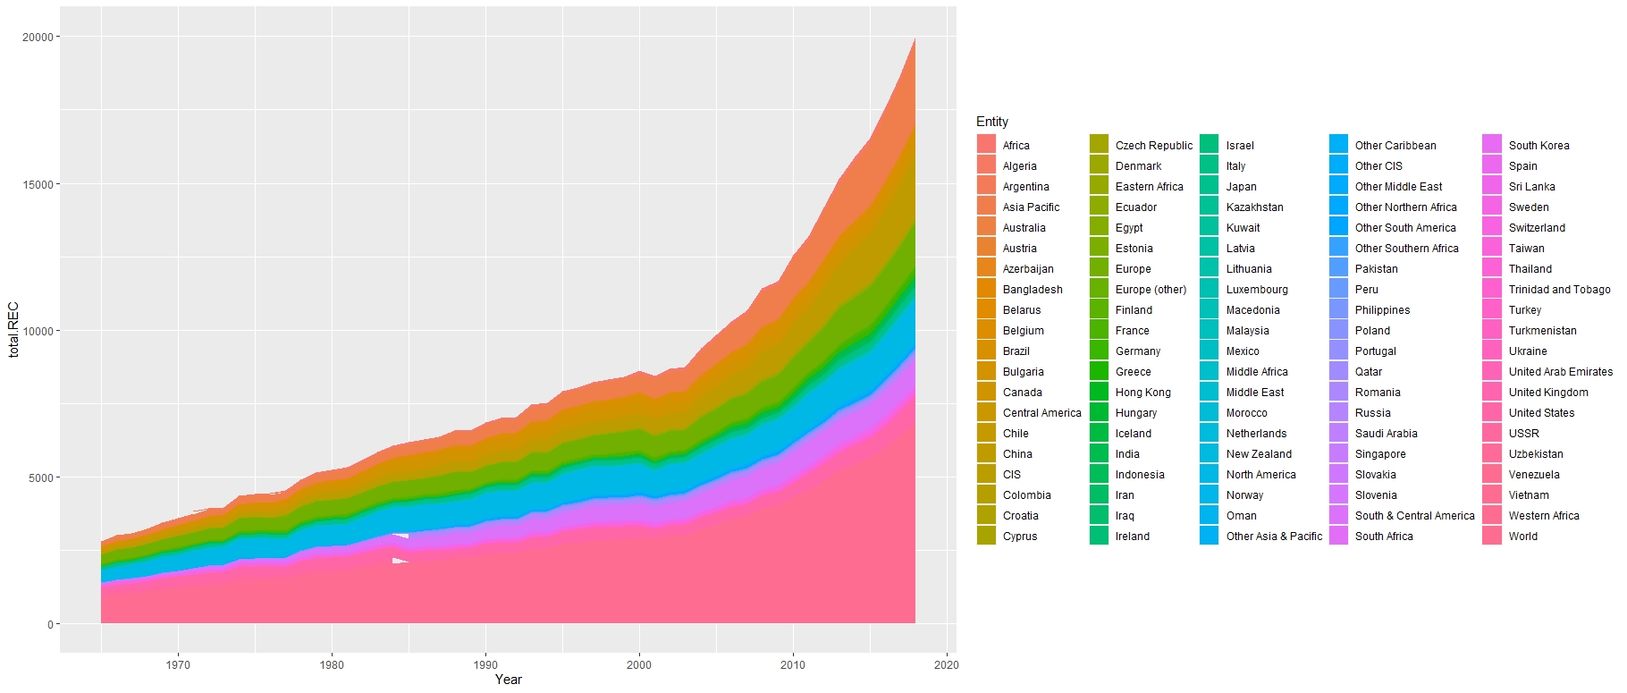
Data Understanding : The chart shows this as a stacked area chart, which allows us to more readily see the breakdown of the renewable mix, and relative contribution of each.

Slide 5
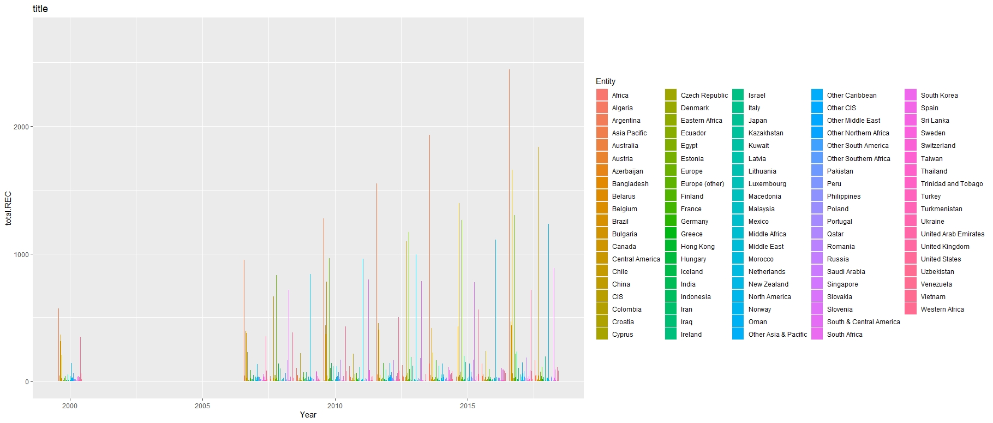
This Graph illustrated the Total Renewable Energy during the 1965-2018. But the value before the 2007 is less, Therefore by using CUMSUM for cumulative the total consumption Renewable Energy during the 1965-2007, and after that used this Graph. This graph is creating for visualization of data to understanding better what happen during the year between 19965-2018.
Data Understanding:

Slide 6
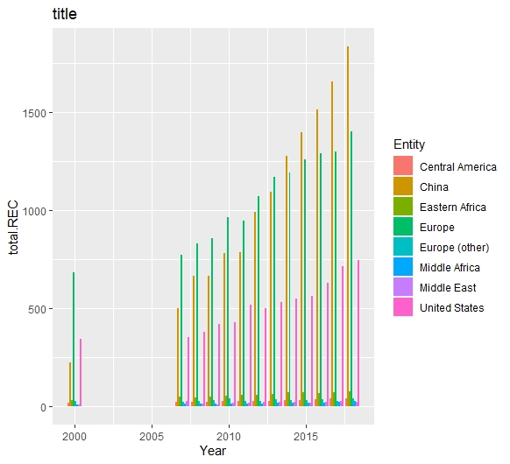
This graph shows that 8 top Renewable Energy Consumer(REC) in the world. To obtain this diagram, Filter, Subset and Full Joint commands have been used.
Data Understanding:

Slide 7
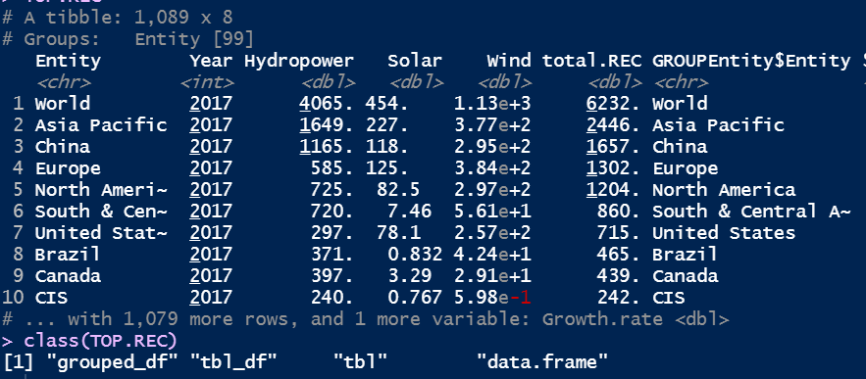
Data Understanding:
10 Top Renewable Energy Consumption in the dataset in 2017. Asia Pacific, North America and Europe are The most important the consumer of Renewable Energy in the world.

Slide 8
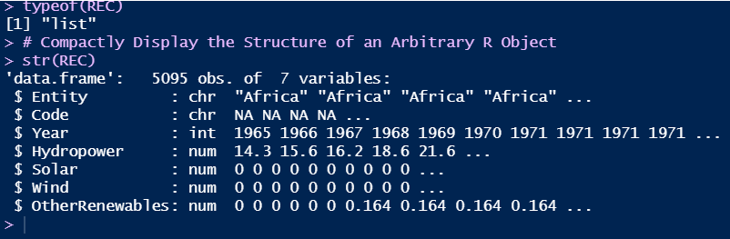
Getting familiar with data for Data Understanding in EDA. Data frame has a 5059 observation and 7 columns. The missing value can be seen in the dataset. The important column is Entity, Year , Hydropower, Solar and Wind, So by using slice the column of Code dropped at the dataset.
Data Understanding:

Slide 9
Feature Engineering:
For preparation and analysis, the dataset 3 Continues COLUMNS and one Categorical Column are added to dataset to make it easy to handle the project.
1. "total.REC“: Total the consumption of Hydropower, Solar, Wind and Other Renewable Energy
REC$total.REC <- NA
REC$total.REC <- rowSums(REC[ ,c(3:6)], na.rm=TRUE)
2. ” cum_total “: cumulative REC consumption
NEWREC$cum_total <- cumsum(NEWREC$total.REC)
3. "Growth.rate“: Growth rate per annul
RECF <- NEWREC %>% group_by(Entity) %>% mutate(Growth.rate = (total.REC-lag(total.REC))/lag(total.REC))
4. “GROUPEntity”:
NEWREC$GROUPEntity <- NEWREC %>% group_by(Entity)

Slide 10
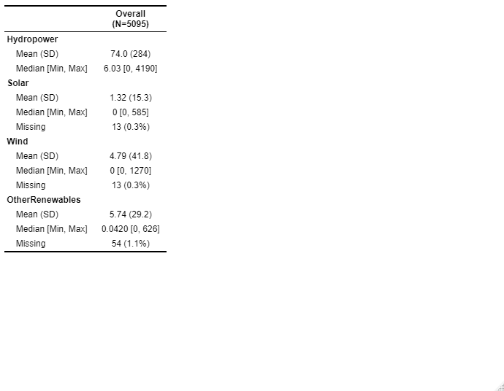
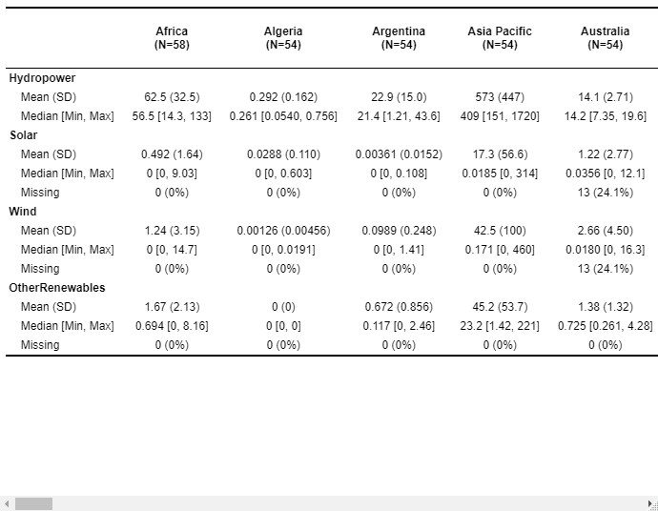
Feature Engineering : Create Descriptive Summary Statistics Tables in R with table1
install.packages("table1")
library("table1")
table1::label(REC$Hydropower) <- "Hydropower"
table1::label(REC$Solar) <- "Solar"
table1::label(REC$Wind) <- "Wind"
table1::label(REC$OtherRenewables) <- "OtherRenewables"
table1::table1(~Hydropower + Solar + Wind + OtherRenewables | Entity, data = REC)
# In the code below, we are showing how to create a table without stratification by any group.
library("table1")
table1::table1(~Hydropower + Solar + Wind + OtherRenewables, data = REC)

Slide 11
Descriptive Statistics: Descriptive statistics comprises three main categories – Frequency Distribution, Measures of Central Tendency, and Measures of Variability. Descriptive statistics helps facilitate data visualization. It allows for data to be presented in a meaningful and understandable way, which in turn, allows for a simplified interpretation of the data set in question.
 | Hydropower | Solar | Wind | Other Renewable Energy | Total Of Renewable Energy
Mean | 74.02 | 1.31 | 4.7 | 5.7 | 85.79
Median | 6.03 | 0 | 0 | 0.042 | 7.53
Standard deviation | 284.48 | 15.3 | 41.77 | 29.1 | 348.9
IQR | 29.1 | 00.2 | 0.03 | 1.3 | 31.98
Hydropower | Solar | Wind | Other Renewable Energy | Total Of Renewable Energy
0.00000 | 0.000000e+00 | 0.000000e+00 | 0.0000 | 0.000000
0.81007 | 0.000000e+00 | 0.000000e+00 | 0.0000 | 1.204431
6.03100 | 0.000000e+00 | 0.000000e+00 | 0.0420 | 7.527449
29.93543 | 2.052632e-03 | 3.030303e-02 | 1.3099 | 33.187437
4193.10415 | 5.846309e+02 | 1.269953e+03 | 625.8054 | 6673.493806

Slide 12
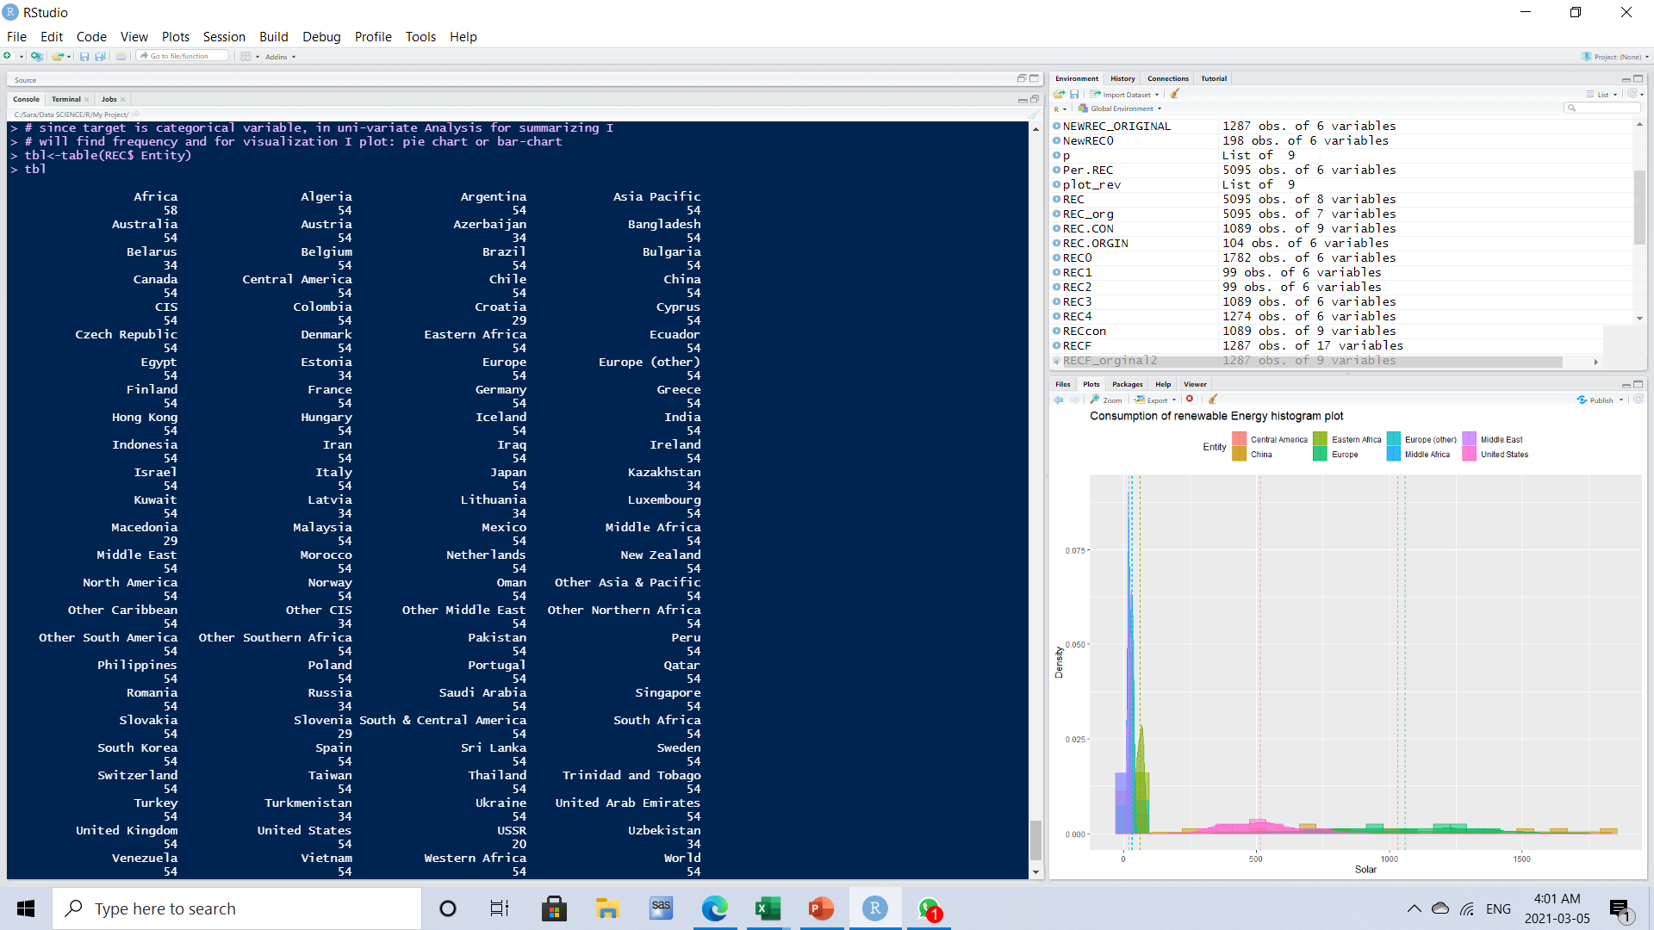
Data preparation:
Data preparation or Data cleaning is:
1) Handling duplicate data
2) Handling Missing Values
3) Handling outliers
By using frequency in a dataset is observed
That data duplication exists in Africa.
This problem is solved by using the
Duplicated command.
sum(duplicated(REC))
RowDuplicate <- which(duplicated(REC))
REC <- REC[-RowDuplicate,]
For handling Missing value in project is
converted missing value to NA and after that use some command in R to handle that.
REC[REC=='']<-NA # converting Null to Na
sum(is.na(REC)) # 11268 number of missing values
colSums(is.na(REC))
This project has outlier but this outlier it
is important for analysis of data. Because this
Outlier happened due to the rapid scientific progress
In this field recently.

Slide 13
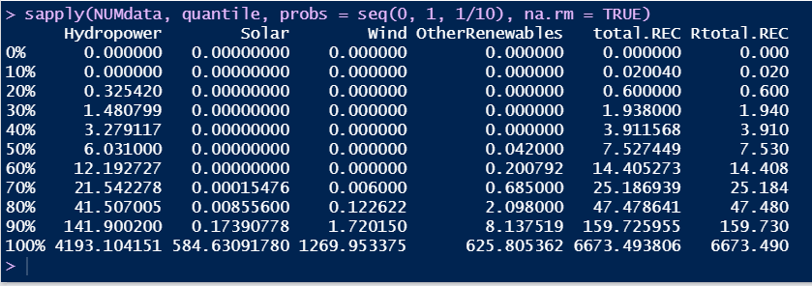
Descriptive Statistics:
sapply(NUMdata, quantile, probs = seq(0, 1, 1/10), na.rm = TRUE)
For atain quartile is used 1/10 for porobs to get 10 quartile for dataset to accuaracy in distribution of data.

Slide 14
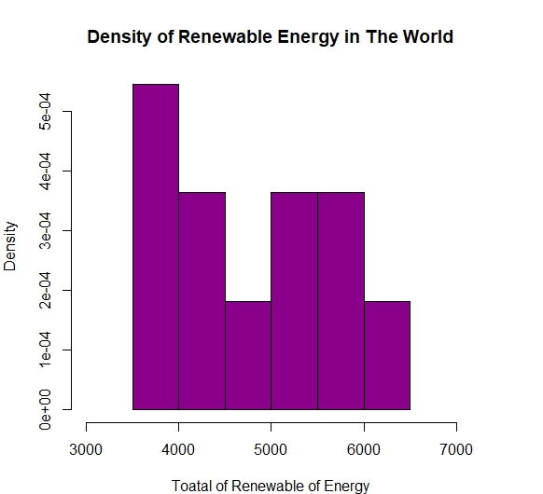
Univariate analysis: For Visualization this Numerical variable (Total of Renewable Energy) plot density is chosen. This diagram shows the consumption of renewable energy versus density.

Slide 15
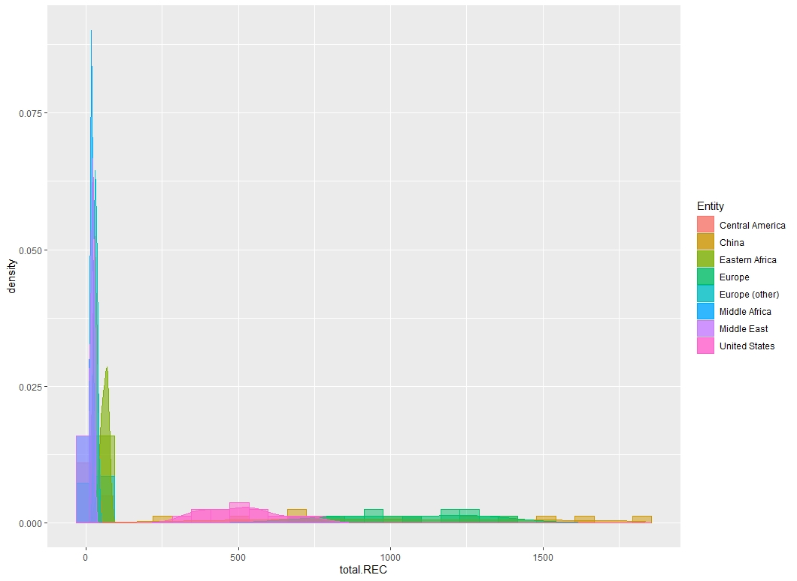
Univariate analysis for Numerical variables : The distribution of “total.REC” shows us , we have mutated recently. Consumption of renewable of energy in the last 10 years. And this graph shows the jump in new energy consumption in recent years.

Slide 16
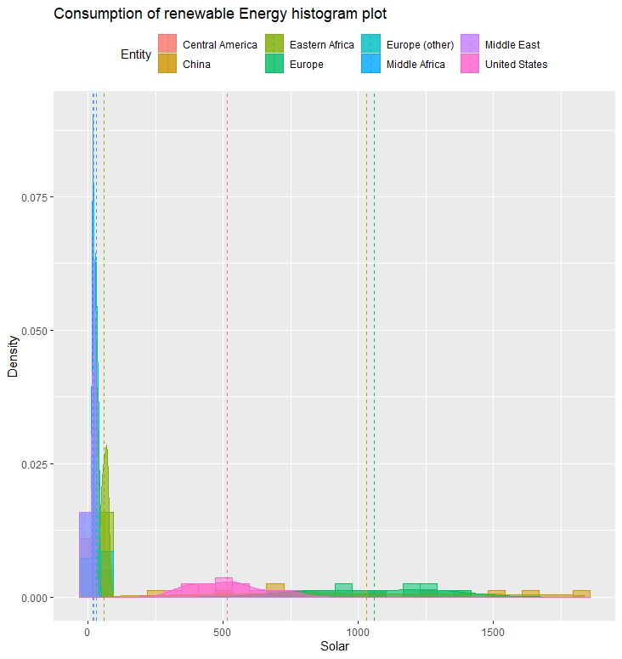
Univariate analysis for Numerical variables :
For Visualization this Numerical variable (Total of Renewable Energy) plot density is chosen. This graph shows , the Solar Energy versus density.

Slide 17
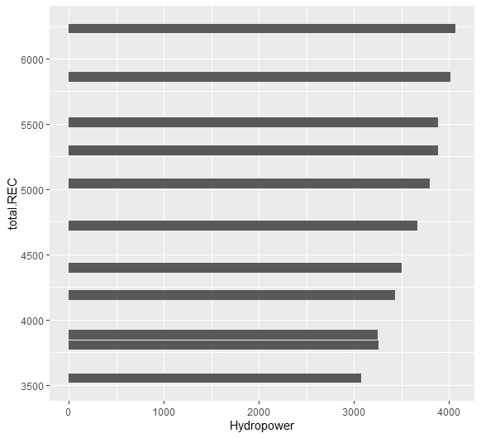
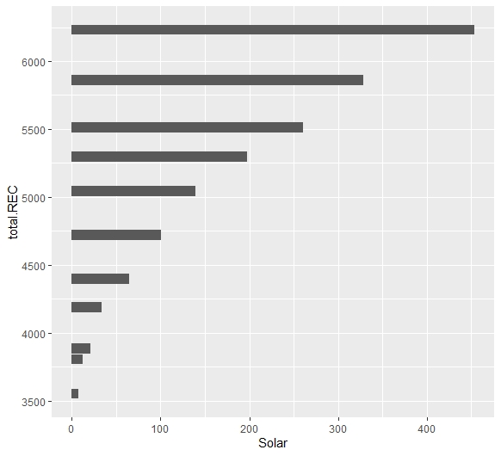
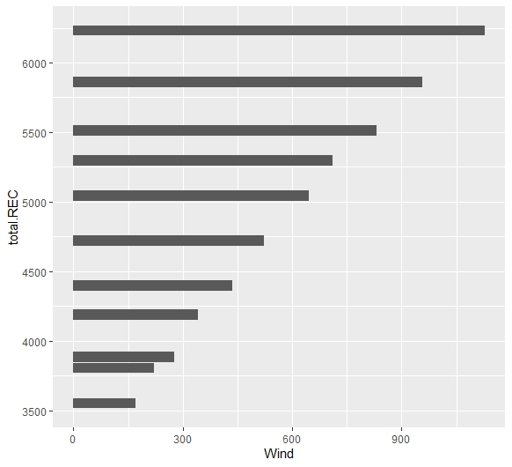
Bi-variate Analysis for Continuous Vs. Continuous: The amount of Consumption Hydropower, Wind and Solar energy of the total of energy. In charts shown here we look at the breakdown of renewable technologies by their individual components – hydropower, solar, wind, and others.

Slide 18
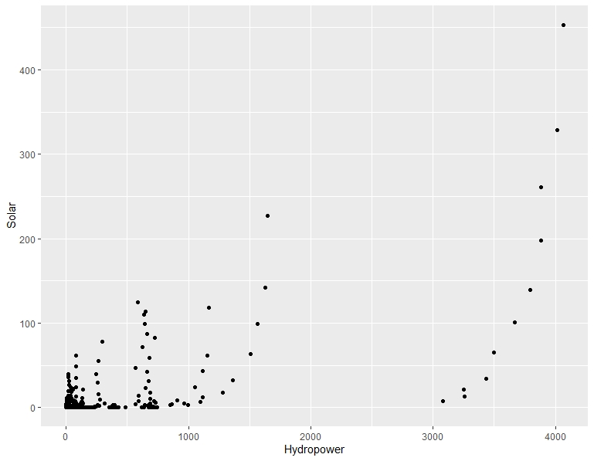
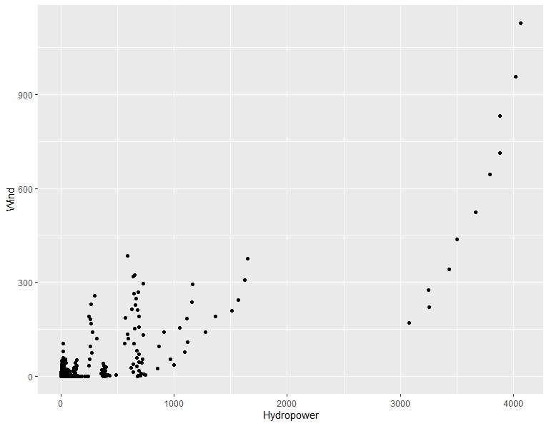
Bi-variate Analysis for Continuous Vs. Continuous: Using scatter plot for showing the relationship between solar versus Hydropower. Also, relationship between Hydropower versus Solar .

Slide 19
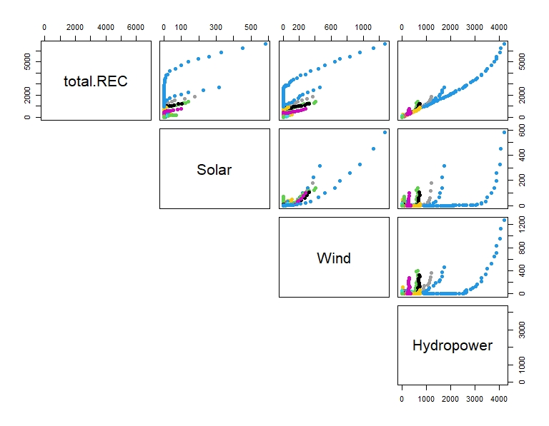
Bi-variate Analysis for Continuous Vs. Continuous: Using scatter plot for showing the relationship between total REC, Solar, Hydropower and wind.

Slide 20
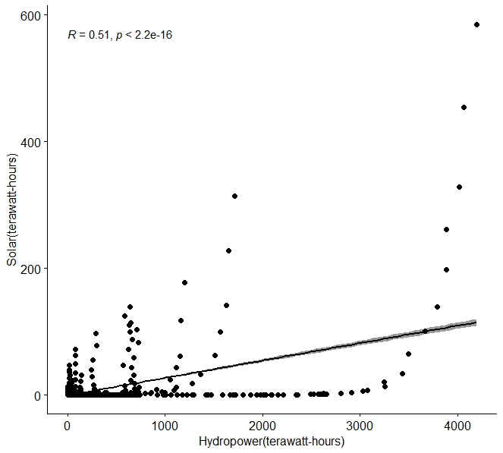
Bi-variate Analysis for Continuous Vs. Continuous:
For test of independence: Pearson correlation or spearman or ...
install.packages("ggpubr")
library("ggpubr")
cor(Hydropower, Solar, method = c("pearson", "kendall", "spearman"))
cor.test(Hydropower, Solar, method=c("pearson", "kendall", "spearman"))
Pearson's product-moment correlation
data: Hydropower and Solar
t = 33.771, df = 1087, p-value < 2.2e-16
alternative hypothesis: true correlation is not equal to 0
95 percent confidence interval:
0.6852688 0.7433522
sample estimates:
cor
0.715545
2.2e-16 < 0.05
Therefore, we fail to reject the null hypothesis

Slide 21
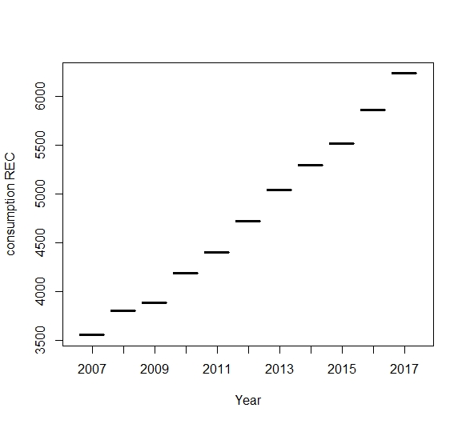
Consumption Renewable Energy during the 2007-2017 in the word. Target Year as a categorical variable in this project. Treating year as a categorical variable will calculate effect of each individual year - i.e., what impact on the target variable was in average each year. On the other hand, including t as numerical variable says what happens on average two years later.
Bi-variate Analysis for Continuous Vs. Categorical:

Slide 22
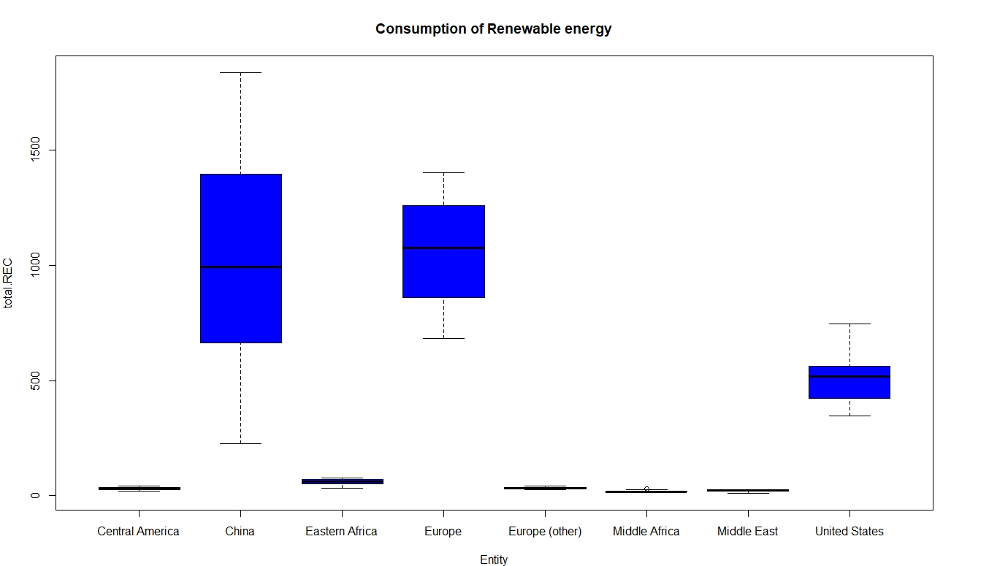
Bi-variate Analysis for Continuous Vs. Categorical : visualization: box plot This graph illustrated the most consumption of Renewable Energy in the world are China, Europe and United States.

Slide 23
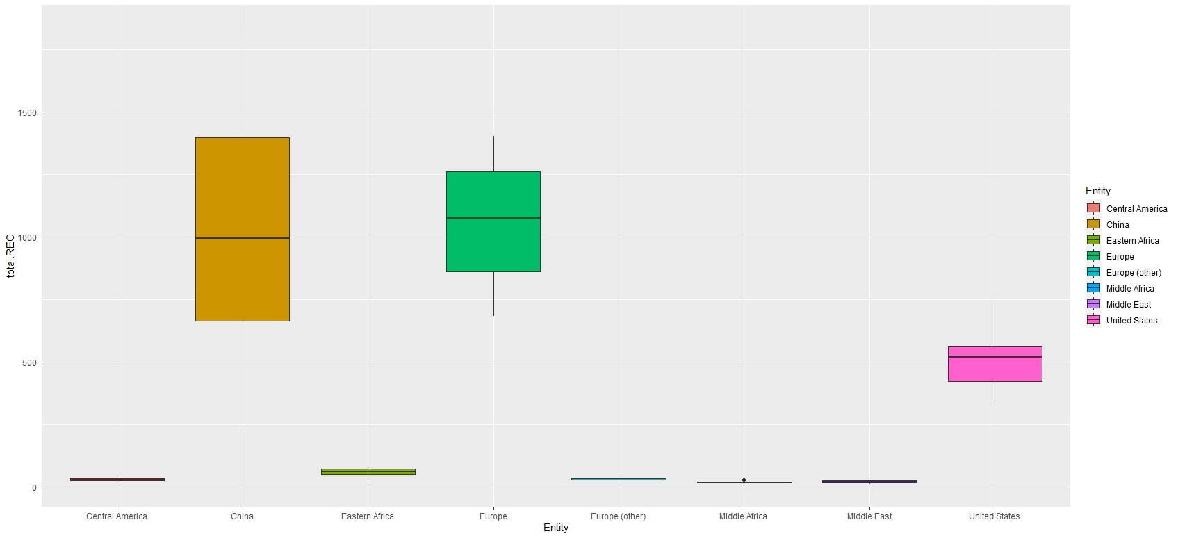
Bi-variate Analysis for Continuous Vs. Categorical: visualization: Grouped box plot Bi-variate Analysis for continuous(total.REC ) Vs. categorical (Entity)

Slide 24
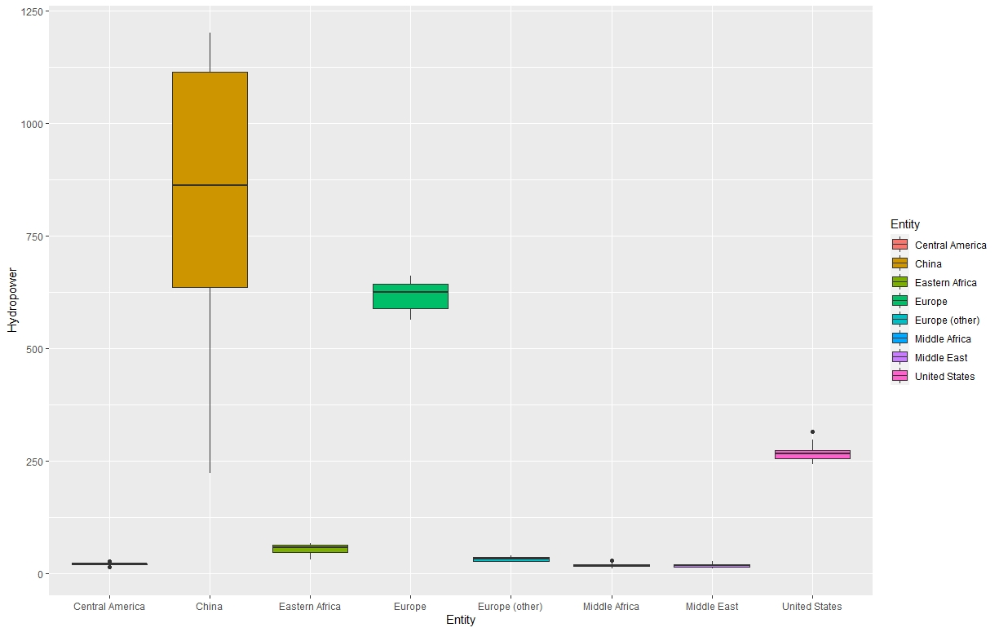
Bi-variate Analysis for Continuous Vs. Categorical: visualization: Grouped box plot Bi-variate Analysis for continuous(Hydropower ) Vs. categorical (Entity)

Slide 25
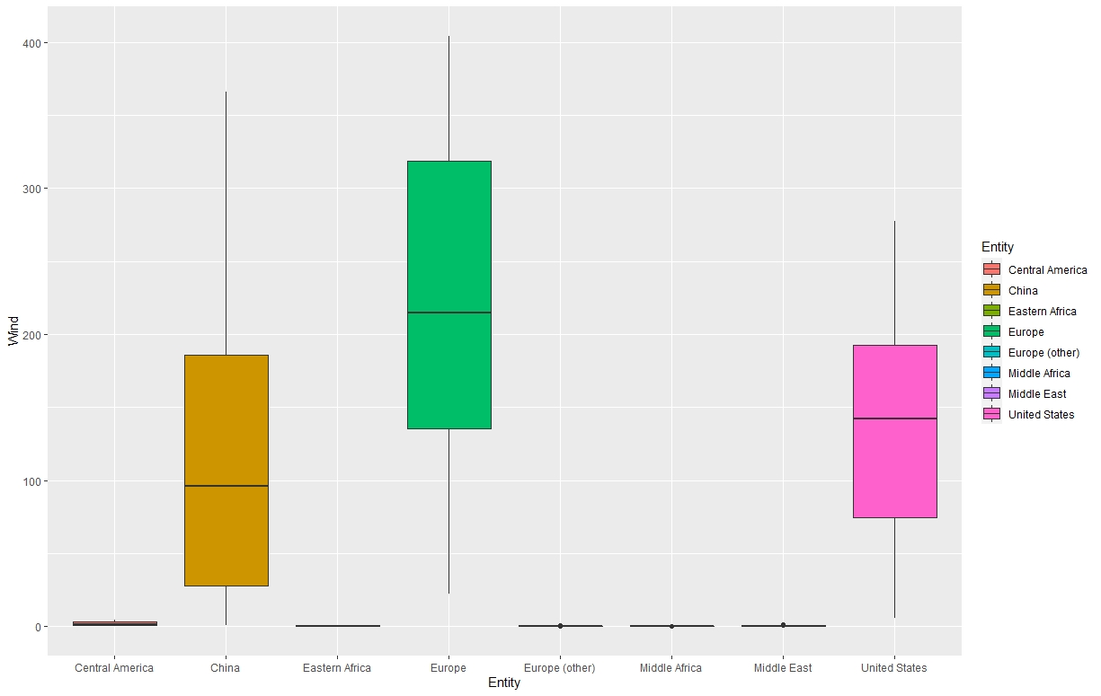
Bi-variate Analysis for Continuous Vs. Categorical: visualization: Grouped box plot Bi-variate Analysis for continuous (Wind ) Vs. categorical (Entity)

Slide 26
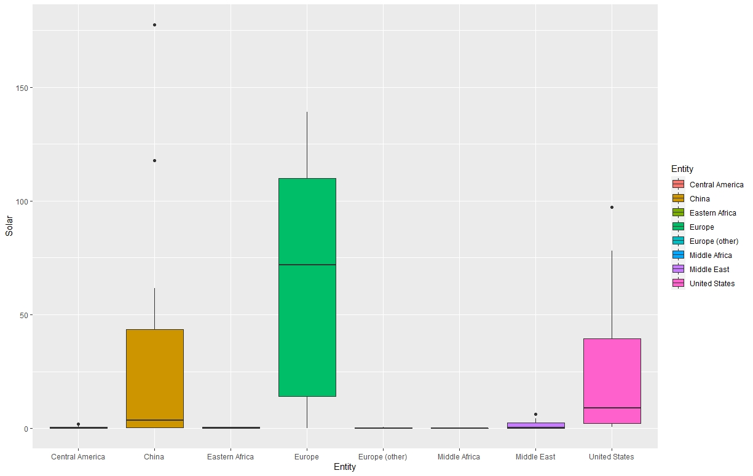
Bi-variate Analysis for Continuous Vs. Categorical: visualization: Grouped box plot Bi-variate Analysis for continuous (Wind ) Vs. categorical (Entity)

Slide 27
Bi-variate Analysis for Continuous Vs. Categorical: visualization: Grouped box plot
By using aggregation function compare the numerical variable is comfortable.
agg2 <- cbind(aggregate( total.REC ~ Entity , REC , min),
aggregate( total.REC ~ Entity , REC , max)[,2],
aggregate( total.REC ~ Entity , REC , mean)[,2])
names(agg2) <- c("total.REC","min_REC","max_REC","mean_REC")
agg2
write.table(agg2, file = "agg2.csv",
sep = "\t", row.names = F)

Slide 28
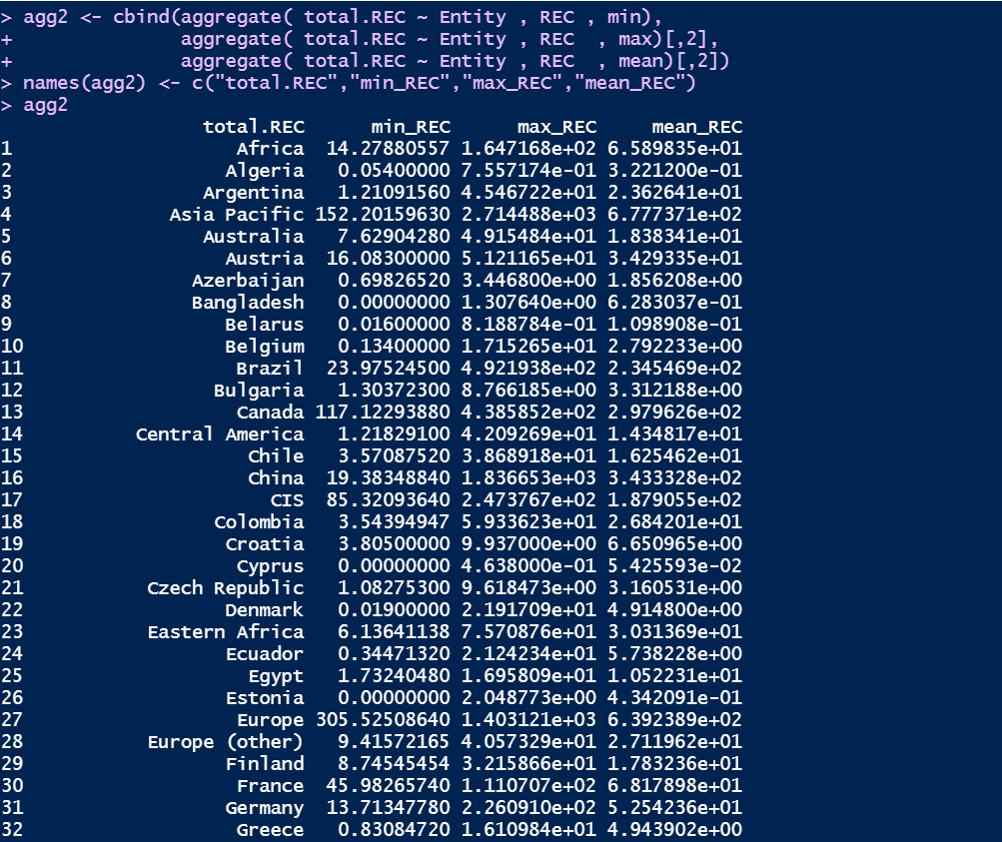
Bi-variate Analysis for Continuous Vs. Categorical: visualization: Grouped box plot Use aggregation Function for attain total consumption versus Entity, and also calculated min, max, mean for them

Slide 29
Bi-variate Analysis for Continuous Vs. Categorical : Test of independence: Anova
Perform the ANOVA test:
One-way ANOVA
In the one-way ANOVA example, we are modeling crop total.REC as a function of the
type of Entity used. First, we will use aov() to run the model, then we
will use summary() to print the summary of the model.
one.way <- aov(total.REC~Entity, data = REC.ORGIN)
summary(one.way)

Slide 30
Bi-variate Analysis for Continuous Vs. Categorical : Test of independence: Anova
Two-way ANOVA
In the two-way ANOVA example, we are modeling crop total.REC as a function of type of Entity and Year. First, we use aov() to run the model, then we use summary() to print the summary of the model.
two.way <- aov(total.REC~Entity + Year, data = REC.ORGIN)
summary(two.way)
Adding interactions between variables
Sometimes you have reason to think that two of your independent variables have an interaction effect rather than an additive effect.
interaction <- aov(total.REC~Entity * Year, data = REC.ORGIN)
summary(interaction

Slide 31
Bi-variate Analysis for Continuous Vs. Categorical : Test of independence: Anova
Adding a Solaring variable
If you have grouped your experimental treatments in some way, or if you have a confounding variable that might affect the relationship you are interested in testing, you should include that element in the model as a Solaring variable. The simplest way to do this is just to add the variable into the
# model with a '+’.
Solaring <- aov(total.REC~Entity + Year + Solar, data = REC.ORGIN)
summary(Solaring)
Find the best-fit model:
There are now four different ANOVA models to explain the data. How do you decide which one to use? Usually, you will want to use the 'best-fit' model -
the model that best explains the variation in the dependent variable.

Slide 32
Bi-variate Analysis for Continuous Vs. Categorical : Test of independence: Anova
install.packages("AICcmodavg")
library("AICcmodavg")
model.set <- list(one.way, two.way, interaction, Solaring)
model.names <- c("one.way", "two.way", "interaction", "Solaring")
aictab(model.set, modnames = model.names)
Check for homoscedasticity
To check whether the model fits the assumption of homoscedasticity, look at the model diagnostic plots in R using the plot() function:
par(mfrow=c(2,2))
plot(two.way)
par(mfrow=c(1,1))

Slide 33
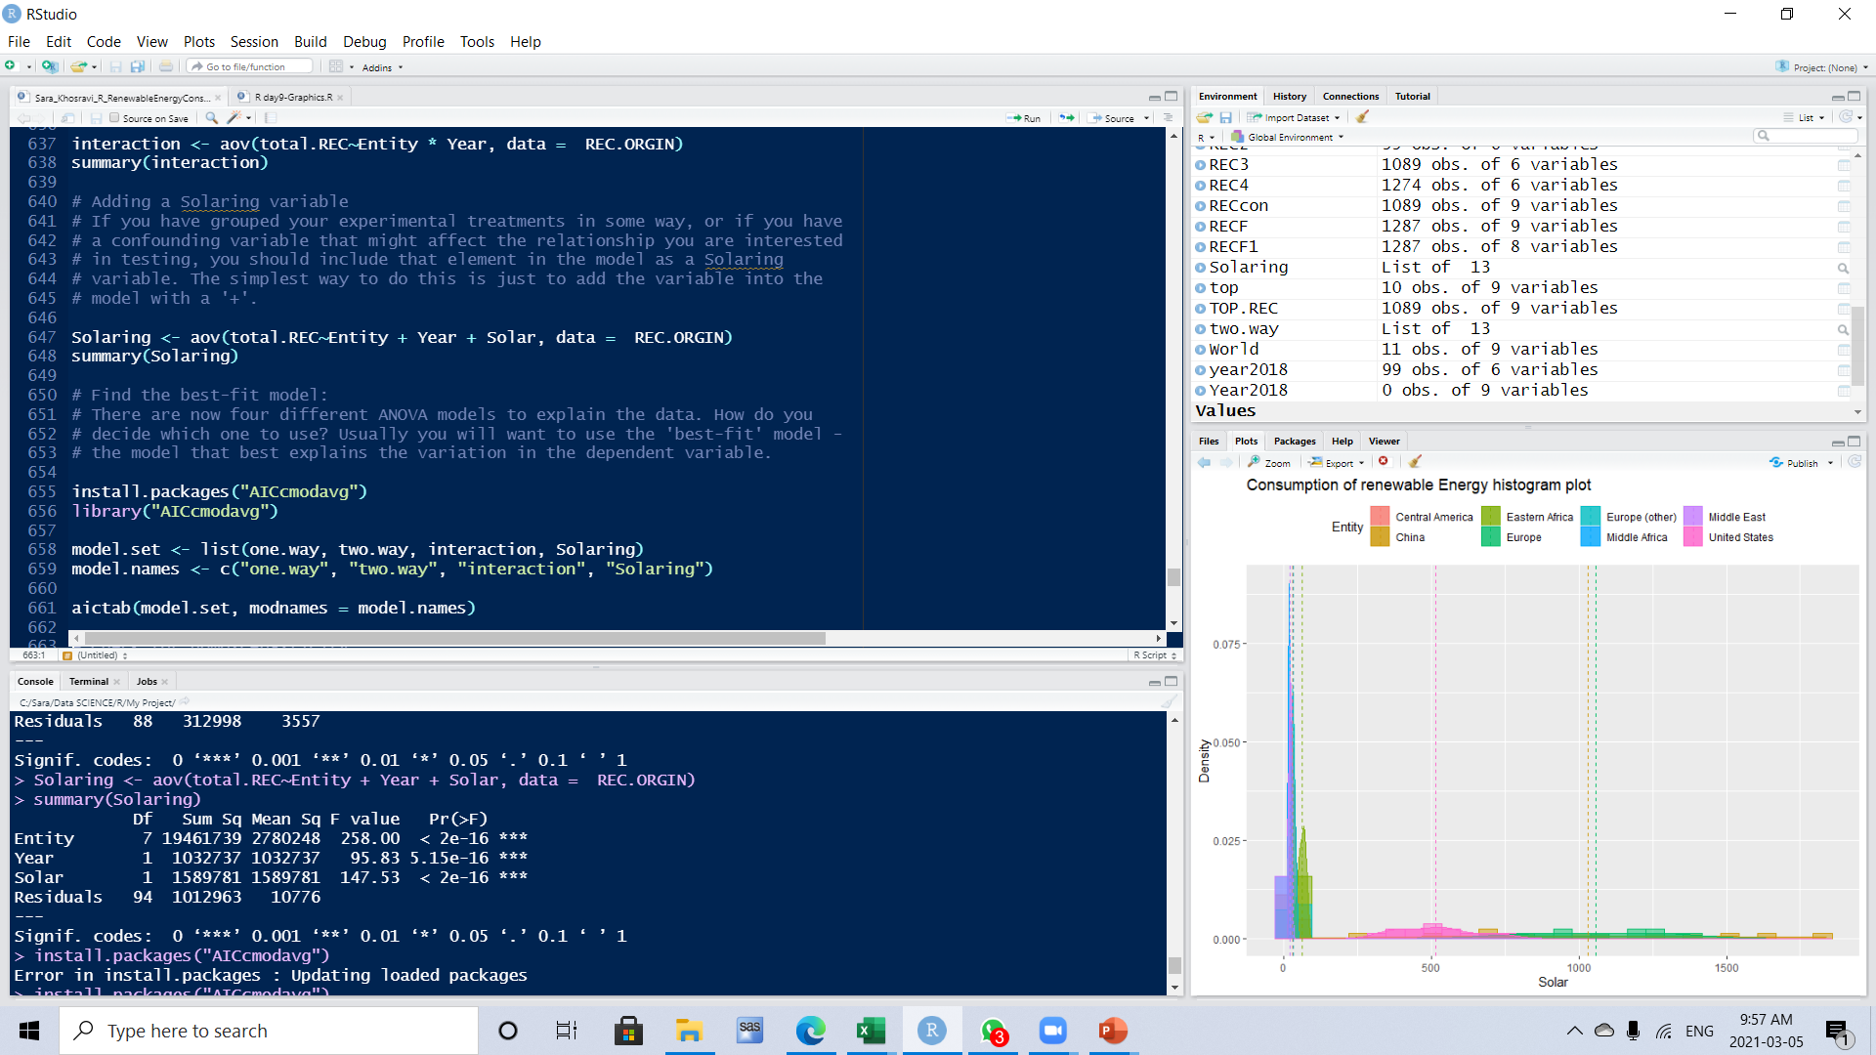
Bi-variate Analysis for Continuous Vs. Categorical : Test of independence: Anova
Focus on the column: the probability that F is greater than the listed value from the previous column. This is often called the p value. In most cases you put significance at the alpha=.05 level, or we require the P value to be less then .05 to be considered statistically significant.
5.115e-16 < 0.05
Therefore, we fail to reject the null hypothesis

Slide 34
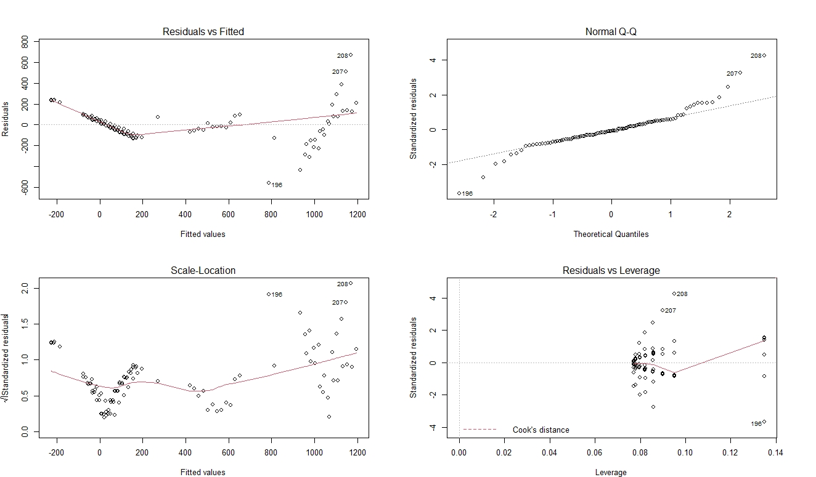
Bi-variate Analysis for Continuous Vs. Categorical : Test of independence: Anova

Slide 35
Conclusion:
We see in this Project the rapid growth of renewable technologies in the World
This interactive chart shows the amount of energy generated from solar power each year.
Solar generation at scale – compared to hydropower, for example – is a relatively modern renewable energy source but is growing quickly in many countries across the world.

Slide 36
Thank you for your attention!

